Slide 1
Summit Structural AZ
Progress update #4

Slide 2
Week 10/16
Slow progress….
Meet with client (!!!!!)
Discussed content needed
Approved theme
Reloaded images and themes after accidental deletion
Activated Google Analytics

Slide 3

Why google analytic ?

Slide 4
Create an analytic account
log into your google account
Analytics.google.com
Sign up for google analytics
Fill in personal information and the URL of the sight that you're trying to track
Agree to the terms and conditions and press the create button

Slide 5
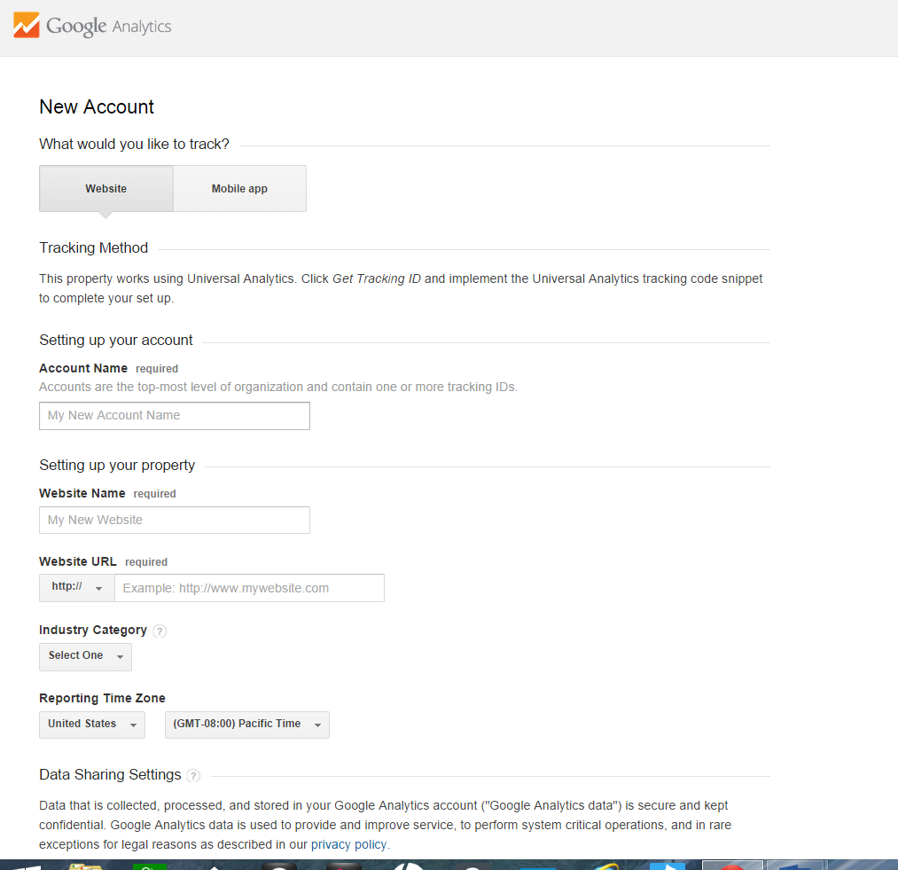

Slide 6
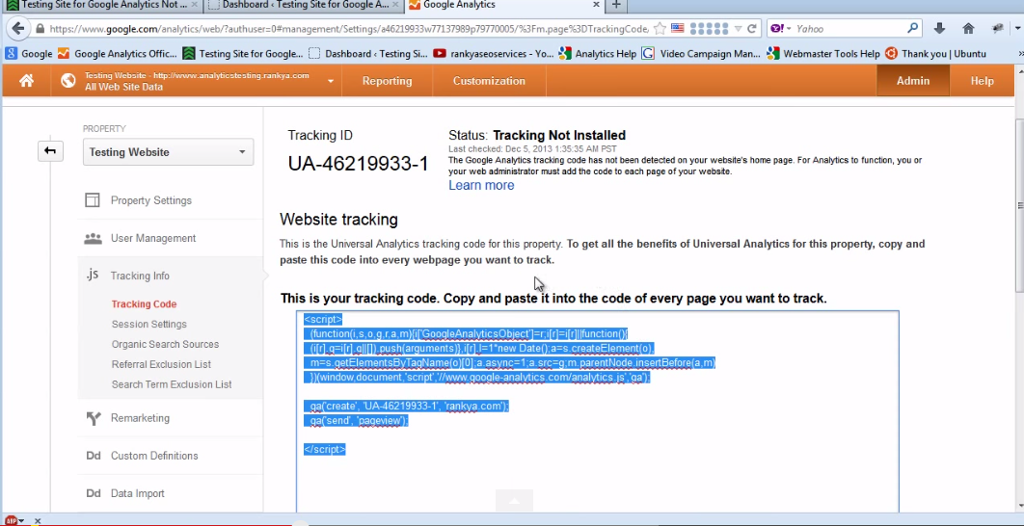
Get tracking ID/Java Script code

Slide 7
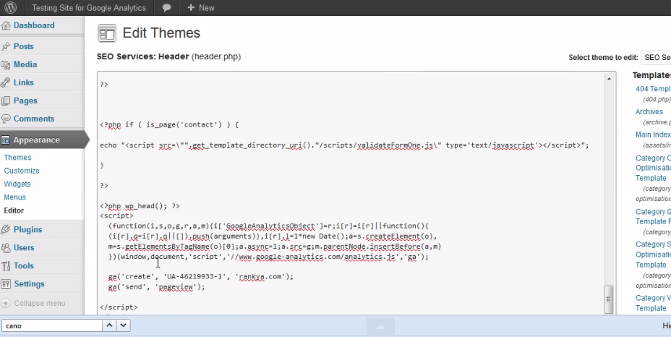
Paste the javascript code into the website

Slide 8
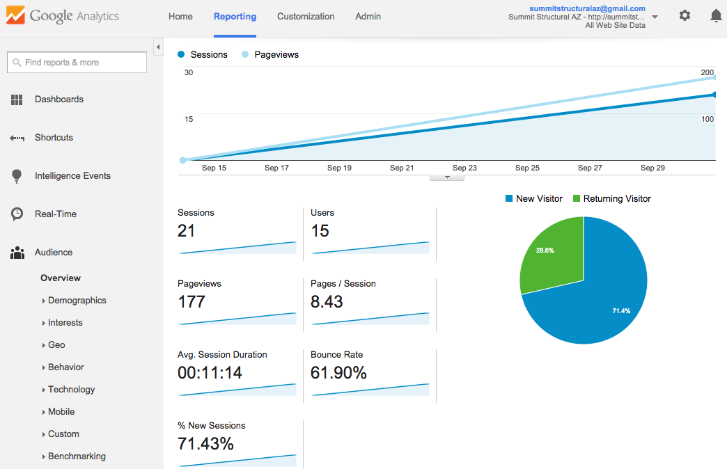
SEO - Getting hits!!

Slide 9
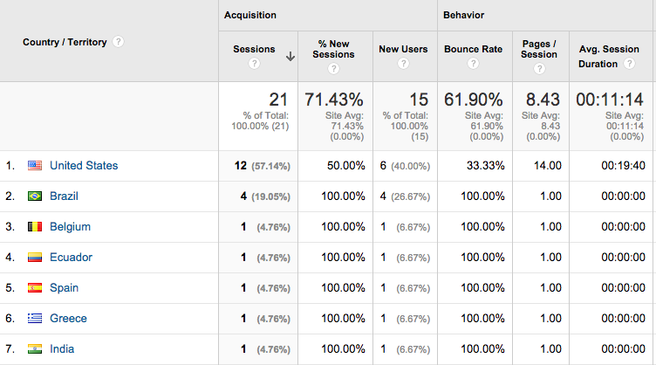
And from other countries!!

Slide 10
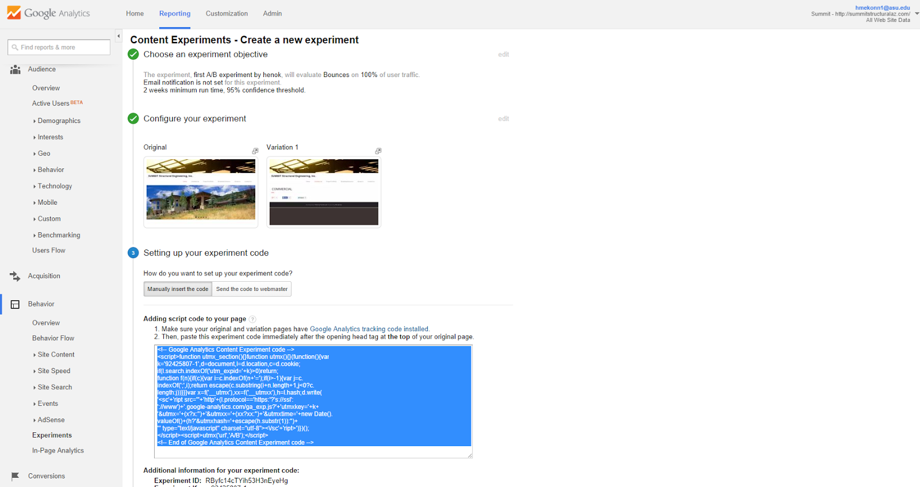
cool edits

Slide 11
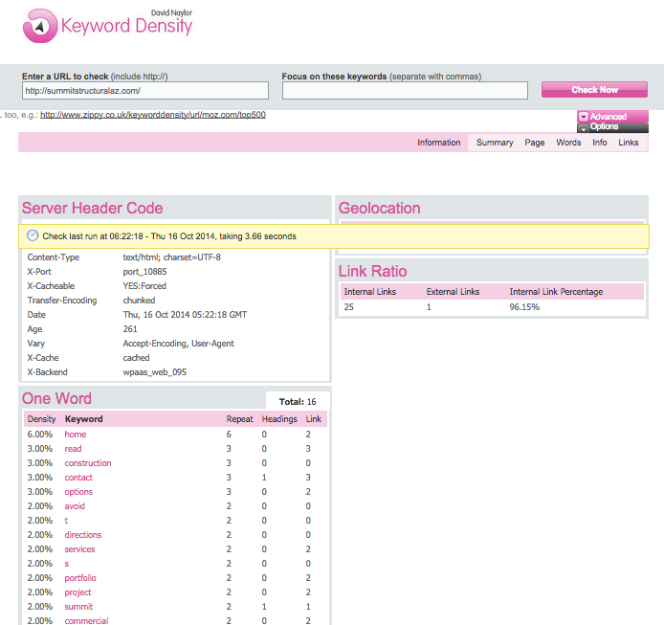
SEO tools - Keyword Density

Slide 12
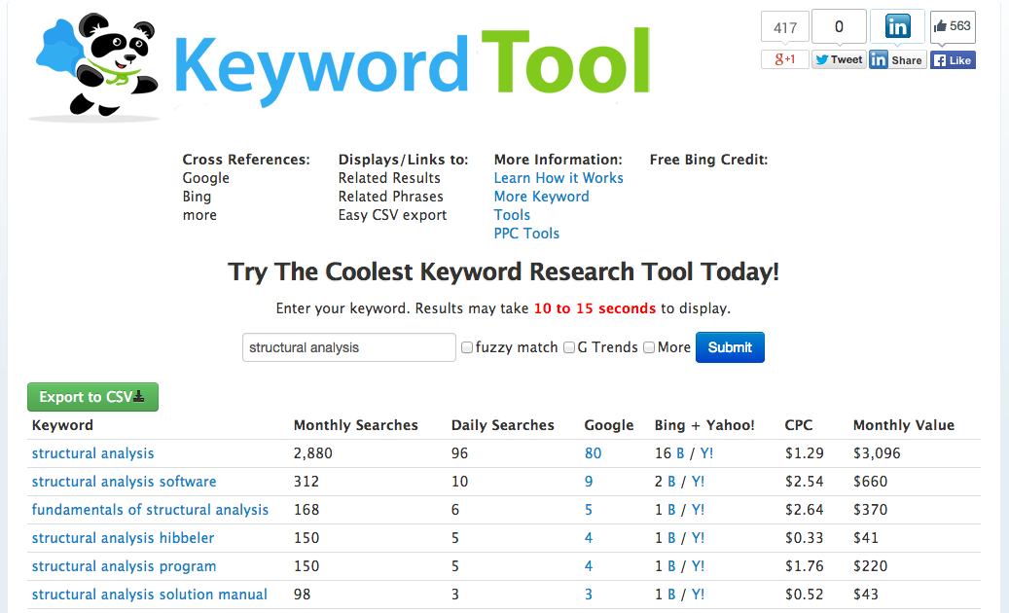
SEO tools - Keyword Tool

Slide 13
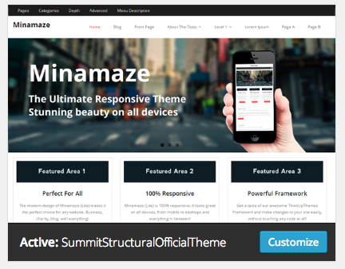
Our own theme

Slide 14

Questions?

